Slide 1
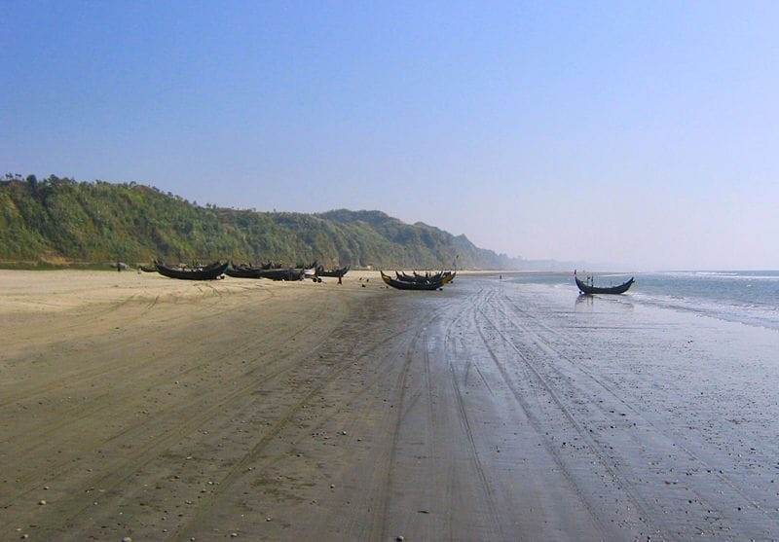
My Memorable Trip to Cox's Bazar
An Unforgettable Journey with a Friend
Prepared By
Antik Paul
ID: 261031015 · Dept. of CSE · 36th Batch (UG)
1/11

Slide 2
Introduction
About This Journey
Traveling is one of the best ways to relax and create unforgettable memories. Last winter, I went on a trip to Cox's Bazar with my close friend. We had been planning this tour for a long time — and finally, we made it happen! From the moment we boarded the bus, we were full of excitement and joy. The long journey felt short because we were having so much fun. This journey became one of the most enjoyable experiences of my life.
📅 Duration
👥 Travelers
Dec 15–18, 2025 4 Days
2 Close Friends Feni → Cox's Bazar
Antik Paul | ID: 261031015 | Dept. of CSE, 36th Batch (UG)
2/11

Slide 3
4-Day Journey at a Glance
Day 1
Day 2
Day 3
Day 4
Dec 15–16
Dec 16
Dec 17
Dec 18
1
2
3
4
First Beach Visit Walked the Shore
Laboni Beach Magical Sunset
Himchari Hilltop Inani Beach
Emotional Farewell Return to Feni
🌊 World's Longest Natural Sea Beach — 120 km of unbroken coastline
Antik Paul | ID: 261031015 | Dept. of CSE, 36th Batch (UG)
3/11

Slide 4
Day 1 — Journey & First Beach Experience
Dec 15–16
🚌 The Journey & Arrival
⏰ 12:00 PM — Departed Feni by bus
We were so excited! The whole ride we talked, laughed and enjoyed the roadside views.
⏰ 7:15 AM — Arrived Cox's Bazar (Dec 16)
⏰ 9:30 AM — First visit to the sea beach 🌊
The vast blue water, the sound of the waves, and the cool breeze made us feel calm and happy. We walked along the shore and took many photos.
⏰ 12:30 PM — Returned after 3 hours on the shore
✨ How It Felt
"Standing at the shore for the first time, we felt all our stress just melt away. It was worth every hour of the journey!"
Antik Paul | ID: 261031015 | Dept. of CSE, 36th Batch (UG)
4/11

Slide 5
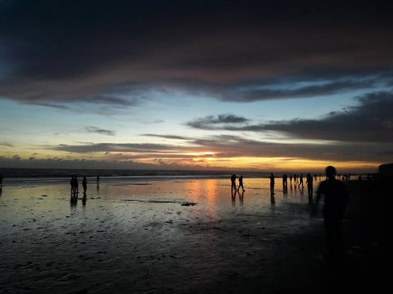
Day 2 — Laboni Beach & The Sunset
Dec 16
🏖️ A Lively Day at Laboni Beach
⏰ 2:30 PM — Visited Laboni Beach
The beach was full of tourists — lively, colorful, and full of energy! We loved the atmosphere.
⏰ 3:00 PM — Coconut water & local snacks 🥥
Sitting by the sea with fresh coconut water was one of the most refreshing feelings of the trip.
⏰ 5:10 PM — Watched the sunset 🌅
We waited patiently and it was worth it. The sky slowly turned orange and red — breathtaking!
"The sky turned orange and red, and the view was truly beautiful. It was like a painting."
Antik Paul | ID: 261031015 | Dept. of CSE, 36th Batch (UG)
5/11

Slide 6
Day 3
"Into the Hills & Along the Shore"
Himchari National Park · Inani Beach · December 17, 2025
The most adventurous day of the entire trip.
Antik Paul | ID: 261031015 | Dept. of CSE, 36th Batch (UG)
6/11

Slide 7
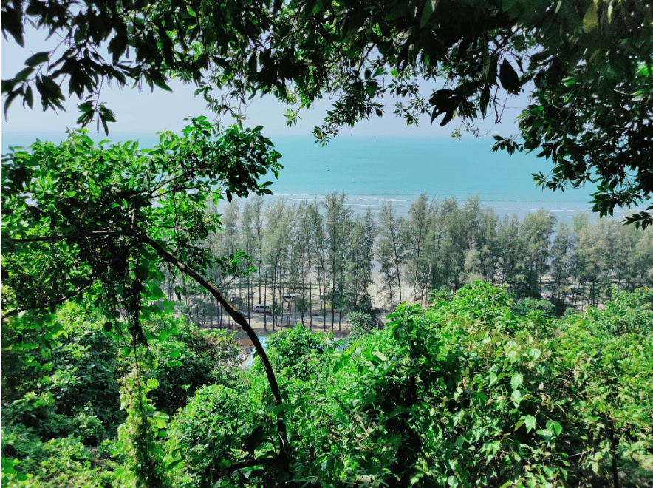
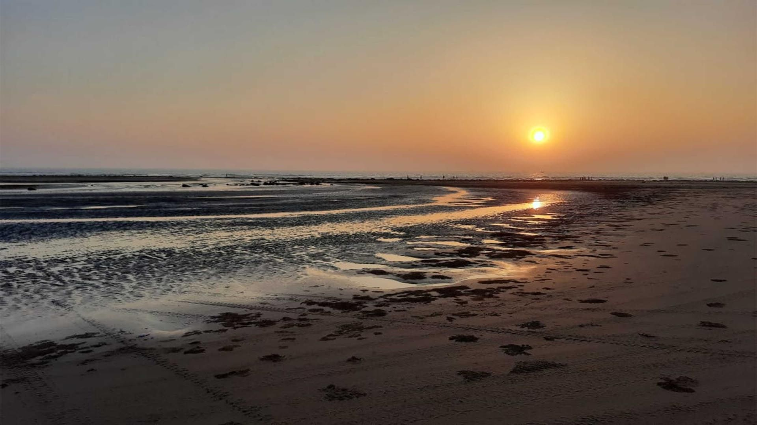
Day 3 — Himchari Park & Inani Beach
Dec 17
🏔️ Himchari National Park
🐚 Inani Beach
⏰ 6:30 AM — Watched the sunrise 🌅 The calm morning felt magical and peaceful. ⏰ 11:00 AM — Reached the hilltop! "The view of the sea and green hills together was simply amazing!"
⏰ 2:15 PM — Arrived Inani Beach So quiet and clean compared to Laboni. The coral stones were incredible! Walked the shore, collected shells 🐚, took countless photos together.
Antik Paul | ID: 261031015 | Dept. of CSE, 36th Batch (UG)
7/11

Slide 8
Day 4 — Final Moments & Return Home
Dec 18
🏠 The Last Day
⏰ 9:00 AM — Final beach visit 🌊
We went one last time to say goodbye to the sea. The morning was peaceful and a little emotional. Neither of us wanted to leave.
⏰ 12:30 PM — Checked out of hotel
Packing felt bittersweet. Every item reminded us what a great time we had.
⏰ 2:30 PM — Journey back to Feni 🚌
We talked about our favorite moments all the way home. The trip lived on in our hearts.
What We Brought Back Home:
📸 Hundreds of beach photos 🐚 Shells from Inani Beach 💙 Stronger friendship than ever 🌊 The sound of waves — forever in our hearts
Antik Paul | ID: 261031015 | Dept. of CSE, 36th Batch (UG)
8/11

Slide 9
What I Learned
"I never thought a 4-day trip could teach me so much. But it did."
❤️
Friends make everything better
Before this trip I knew we were close, but after 4 days together — the bus ride, the beach, the hilltop — I realized how much better everything is when you share it with the right person.
🌊
Nature can reset your whole mood
I was stressed before this trip. Standing at the sea for the first time, watching the waves, breathing the salt air — I felt like a different person. I did not expect that.
✍️
Some moments are worth writing about
I am someone who rarely keeps notes. But when I got home, I wrote everything down. The sounds, the smells, the sunset colors. I did not want to forget any of it.
Antik Paul | ID: 261031015 | Dept. of CSE, 36th Batch (UG)
9/11

Slide 10
Conclusion
"This trip to Cox's Bazar was one of the best experiences of my life. Every day was full of joy, new places, and beautiful moments. Spending time with my friend and enjoying the natural beauty of the world's longest sea beach made this journey truly unforgettable. I will always remember this trip and hope to visit again in the future."
🌊 World's Longest Beach 🏔️ Nature's Beauty 🤝 Friendship 🐚 Priceless Memories ✨ Unforgettable
Antik Paul | ID: 261031015 | Dept. of CSE, 36th Batch (UG)
10/11

Slide 11
THANK YOU
It was a journey worth remembering. 🌊
Presented By
Antik Paul
ID: 261031015
Dept. of CSE · 36th Batch (UG)
🌊 Cox's Bazar, Bangladesh · December 2025 · English Assignment
11/11

