Slide 1
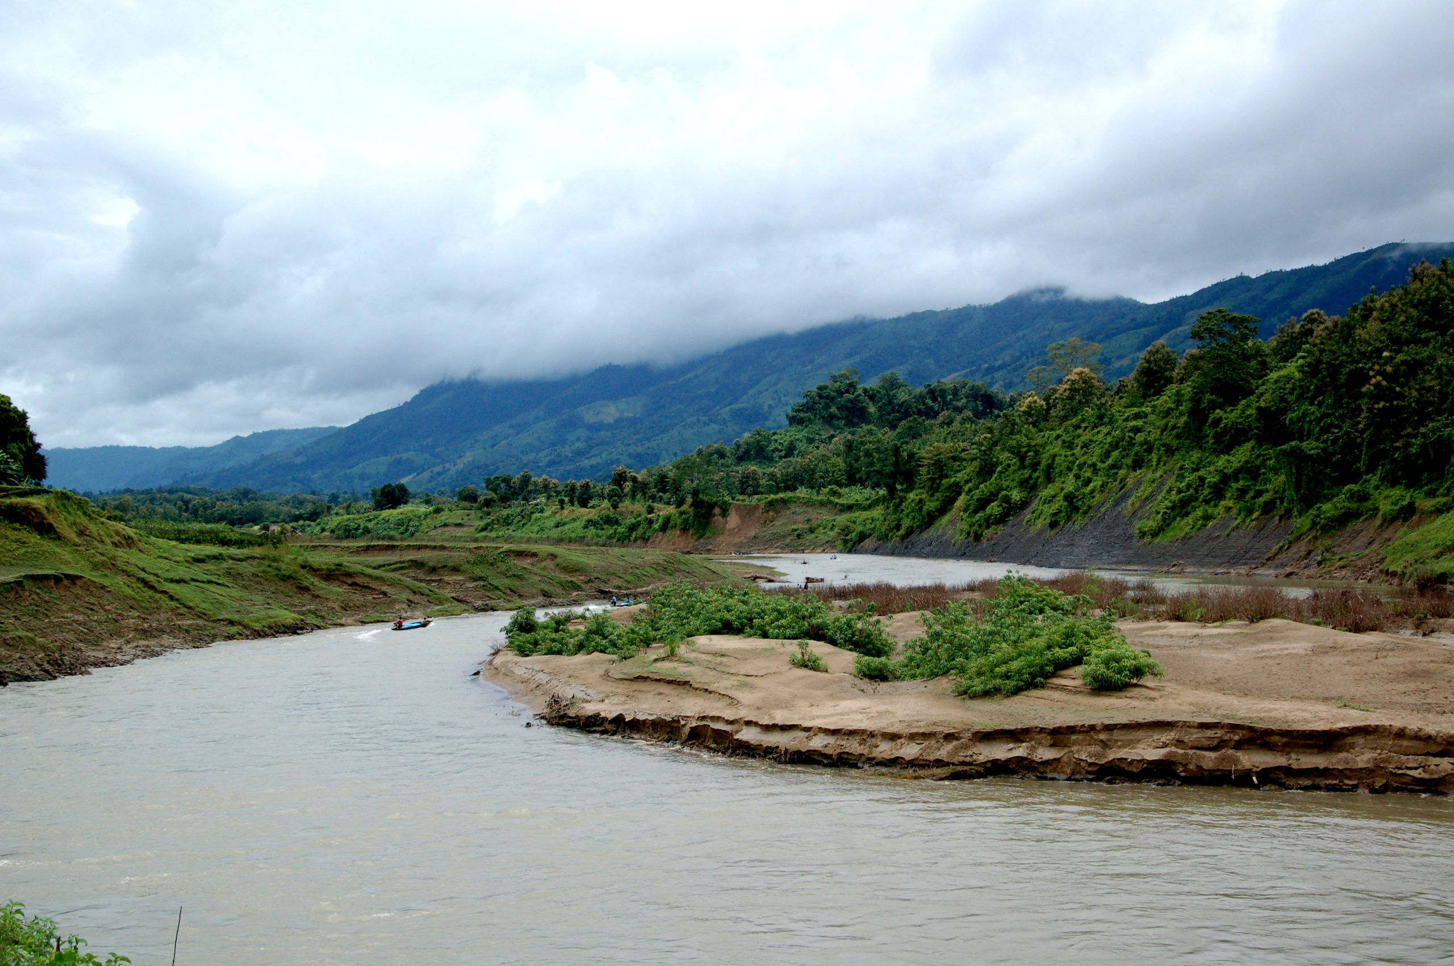
My Favorite Place
Thanchi: A Memorable Tour
with My Friend
English Assignment · CSE UG 36th Batch · December 2025
Prepared By
Ibtiaz Chowdhury
ID: 261031023 · Dept. of CSE · 36th Batch (UG)
🏔️ Thanchi Upazila, Bandarban, Bangladesh
Ibtiaz Chowdhury | ID: 261031023 | Dept. of CSE, 36th Batch (UG)
1/10

Slide 2
Introduction
About This Journey
Traveling is one of the best ways to explore the
beauty of nature and refresh our minds.
Recently, I had the opportunity to spend three
unforgettable days in Thanchi Upazila — one of
the most beautiful and peaceful places in Bangladesh.
Surrounded by green hills, rivers, and natural beauty,
this trip became one of the most memorable
experiences of my life.
📅 Duration
📍 Location
Dec 20–22, 2025
3 Days
Thanchi, Bandarban
Bangladesh
Ibtiaz Chowdhury | ID: 261031023 | Dept. of CSE, 36th Batch (UG)
2/11

Slide 3
3-Day Journey at a Glance
Day 1
Day 2
Day 3
Dec 20
Dec 21
Dec 22
1
2
3
Feni → Thanchi
Sangu River Boat Ride
Remakri & Nafakhum
Waterfall Adventure
Hills & Viewpoints
Return to Feni
🏔️ Thanchi Upazila — Bandarban Hill Tracts — One of Bangladesh's Most Beautiful Destinations
Ibtiaz Chowdhury | ID: 261031023 | Dept. of CSE, 36th Batch (UG)
3/11

Slide 4
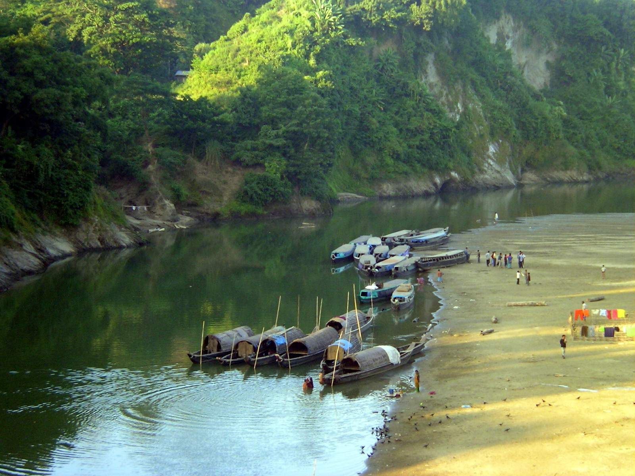
Day 1 — Journey & The Sangu River
Dec 20–21
🚌 The Journey Begins
⏰ 10:00 PM — Departed Feni by bus
I was very excited! I spent the journey
listening to music and thinking about the adventure.
⏰ 7:00 AM — Arrived Bandarban (Dec 21)
⏰ 8:00 AM — Jeep (Chander Gari) to Thanchi
The green hills and dense forests looked amazing.
The air became fresher as we entered the hills.
⏰ 2:00 PM — Visited the Sangu River 🌊
The clear water and peaceful environment made
me feel calm. The boat ride was wonderful!
✨ First Impression
"The clear water and peaceful environment made
me feel calm and happy. A boat ride on the
Sangu River — pure magic."
Ibtiaz Chowdhury | ID: 261031023 | Dept. of CSE, 36th Batch (UG)
4/11

Slide 5
Day 2
"Remakri & Nafakhum — The Waterfall Adventure"
Remakri · Nafakhum Waterfall · December 21, 2025
The most adventurous day of the entire trip.
Ibtiaz Chowdhury | ID: 261031023 | Dept. of CSE, 36th Batch (UG)
5/11

Slide 6
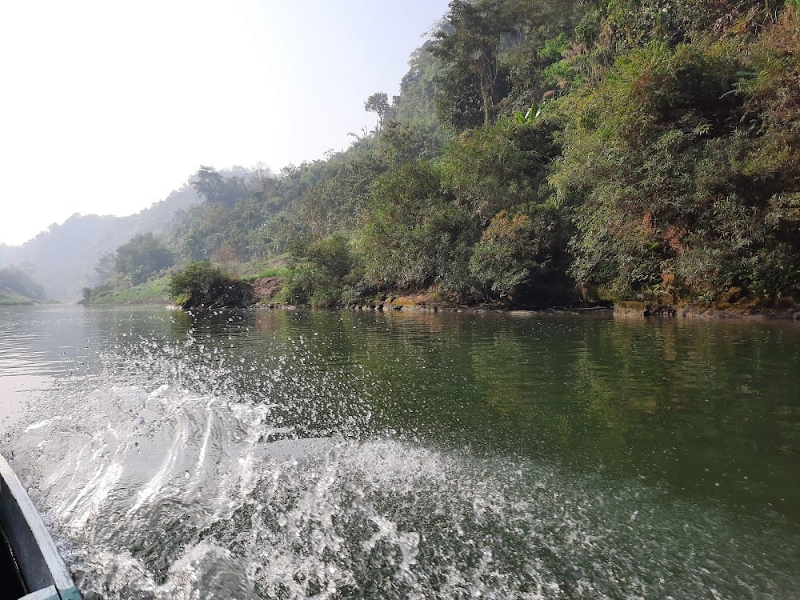
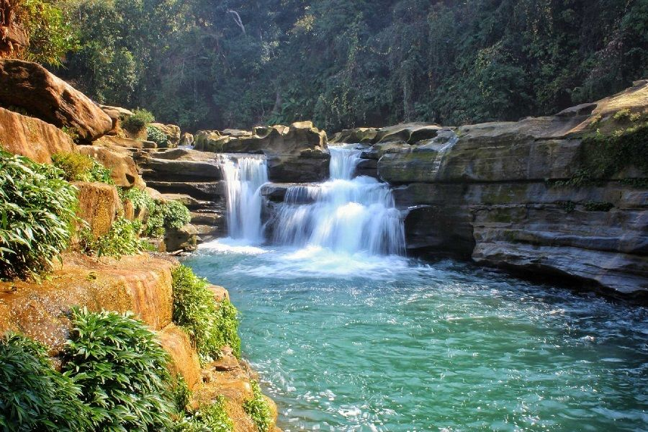
Day 2 — Remakri & Nafakhum Waterfall
Dec 21
🚤 Journey to Remakri by Boat
💧 Nafakhum Waterfall
⏰ 6:00 AM — Woke up early
⏰ 7:00 AM — Departed by boat
The journey was challenging but full of
natural beauty.
⏰ 11:30 AM — Arrived at Remakri
⏰ 12:30 PM — Trekked to Nafakhum
⏰ 2:00 PM — Reached the waterfall!
"The waterfall was powerful and
breathtaking. The sound of the water
left me speechless!"
Returned to Thanchi by evening.
Ibtiaz Chowdhury | ID: 261031023 | Dept. of CSE, 36th Batch (UG)
6/11

Slide 7
Day 3 — Hills, Viewpoints & Return Home
Dec 22
🏔️ The Last Morning in Thanchi
⏰ 7:30 AM — Woke up peacefully
The fresh air and quiet environment made
me feel completely relaxed and refreshed.
⏰ 9:00 AM — Visited nearby hills & viewpoints
The scenic beauty was amazing. I took many
photos — a perfect way to spend the last day.
⏰ 12:30 PM — Packed bags & got ready to leave
Although I felt sad to leave, I was happy
with all the beautiful memories I had made.
⏰ 1:30 PM — Return journey to Feni 🚌
"I will always remember this trip and
hope to visit Thanchi again in the future."
Ibtiaz Chowdhury | ID: 261031023 | Dept. of CSE, 36th Batch (UG)
7/11

Slide 8
What I Learned
"I went to Thanchi looking for an adventure. I came back with something more — a clearer head and a deeper appreciation for simple things."
🏔️
Hard paths lead to the best views
The trek to Nafakhum was not easy. But when I heard that waterfall, none of the difficulty mattered. It was worth every step.
🌊
Nature resets the mind completely
Standing by the Sangu River, I felt more at peace than I had in a very long time. Nature has a way of making everything better.
📸
Some moments deserve to be remembered
This trip forced me to slow down, look around, and actually feel the place I was in. I want to carry that habit into everyday life.
Ibtiaz Chowdhury | ID: 261031023 | Dept. of CSE, 36th Batch (UG)
8/11

Slide 9
Conclusion
"This 3-day trip to Thanchi was one of the best experiences of my life.
Each day was full of adventure, natural beauty, and peaceful moments.
It helped me relax and enjoy life away from the busy city.
I will always remember this trip and hope to visit Thanchi again in the future."
🏔️ Green Hills 🌊 Sangu River 💧 Nafakhum Falls 🚤 Boat Adventure ✨ Unforgettable
Ibtiaz Chowdhury | ID: 261031023 | Dept. of CSE, 36th Batch (UG)
9/11

Slide 10
THANK YOU
It was a journey worth remembering. 🏔️
Presented By
Ibtiaz Chowdhury
ID: 261031023
Dept. of CSE · 36th Batch (UG)
🏔️ Thanchi, Bandarban · December 2025 · English Assignment
Ibtiaz Chowdhury | ID: 261031023 | Dept. of CSE, 36th Batch (UG)
10/10

