Slide 1
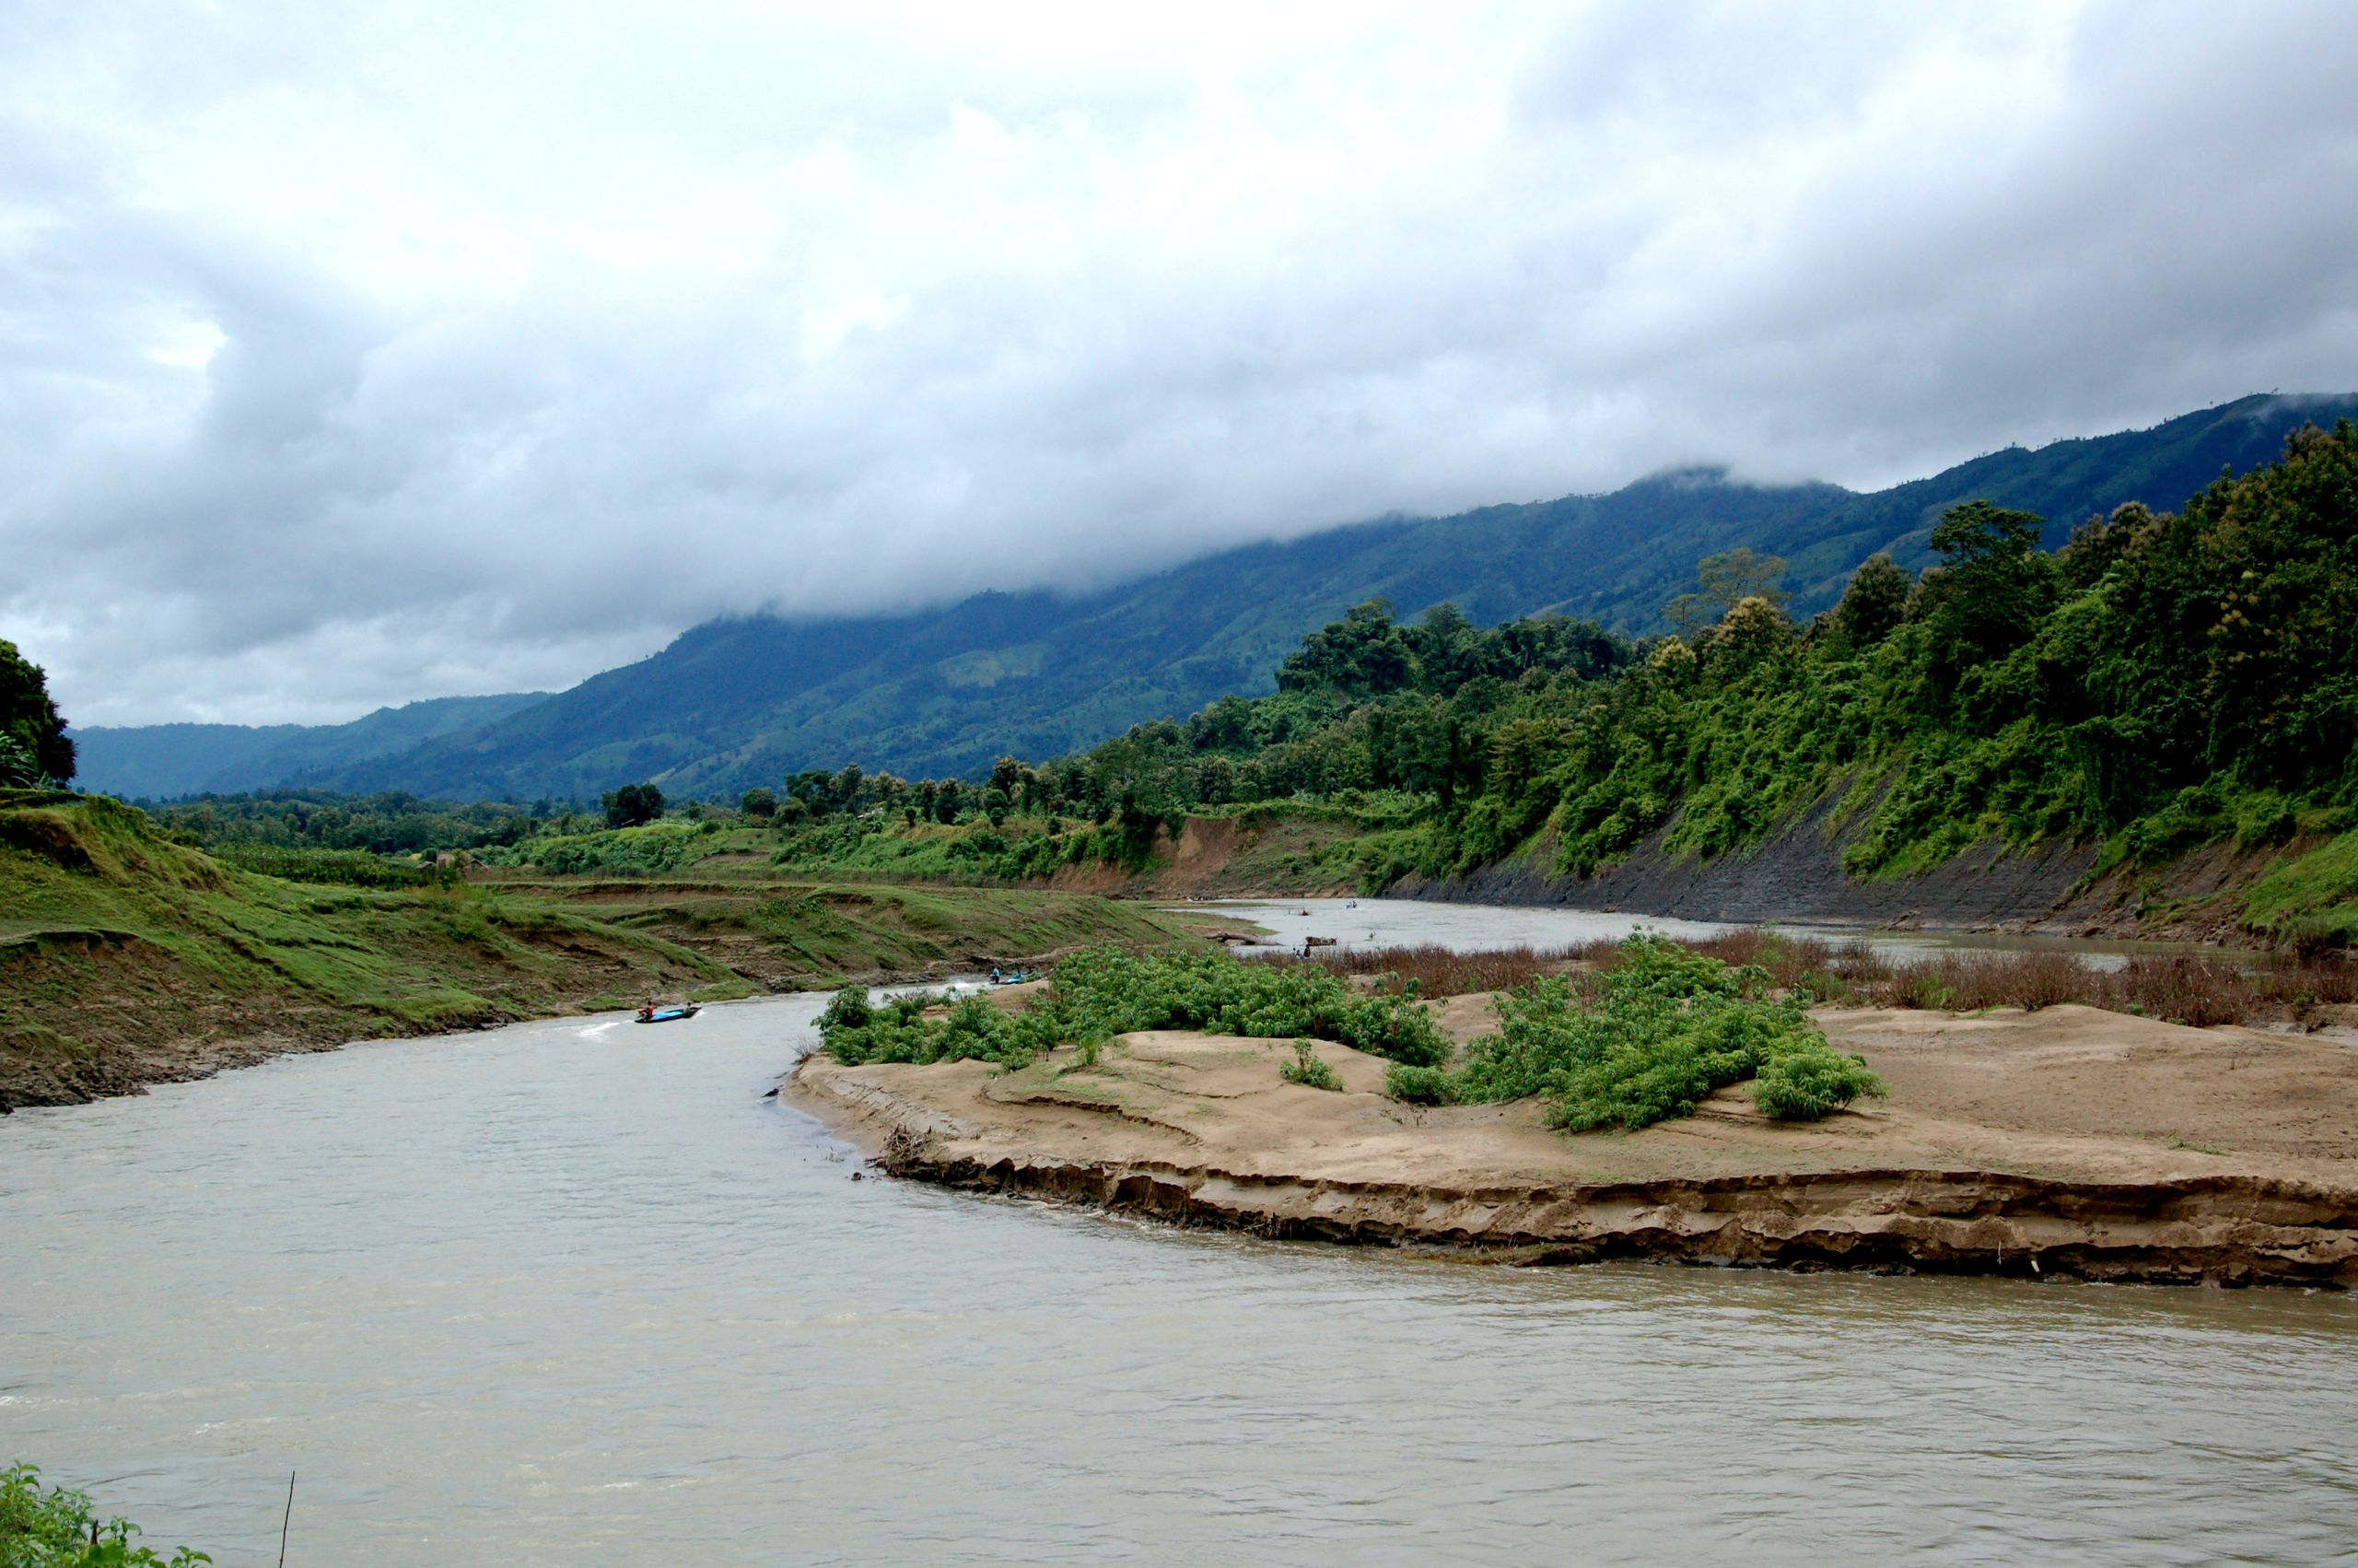
MY FAVORITE PLACE
Thanchi
A Memorable Tour with My Friend
Bandarban Hill Tracts, Bangladesh
December 20–22, 2025
Prepared By
Ibtiaz Chowdhury
ID: 261031023 · CSE, 36th Batch (UG)
🏔️ Thanchi Upazila, Bandarban
Ibtiaz Chowdhury | ID: 261031023 | Dept. of CSE, 36th Batch (UG)
1/8

Slide 2
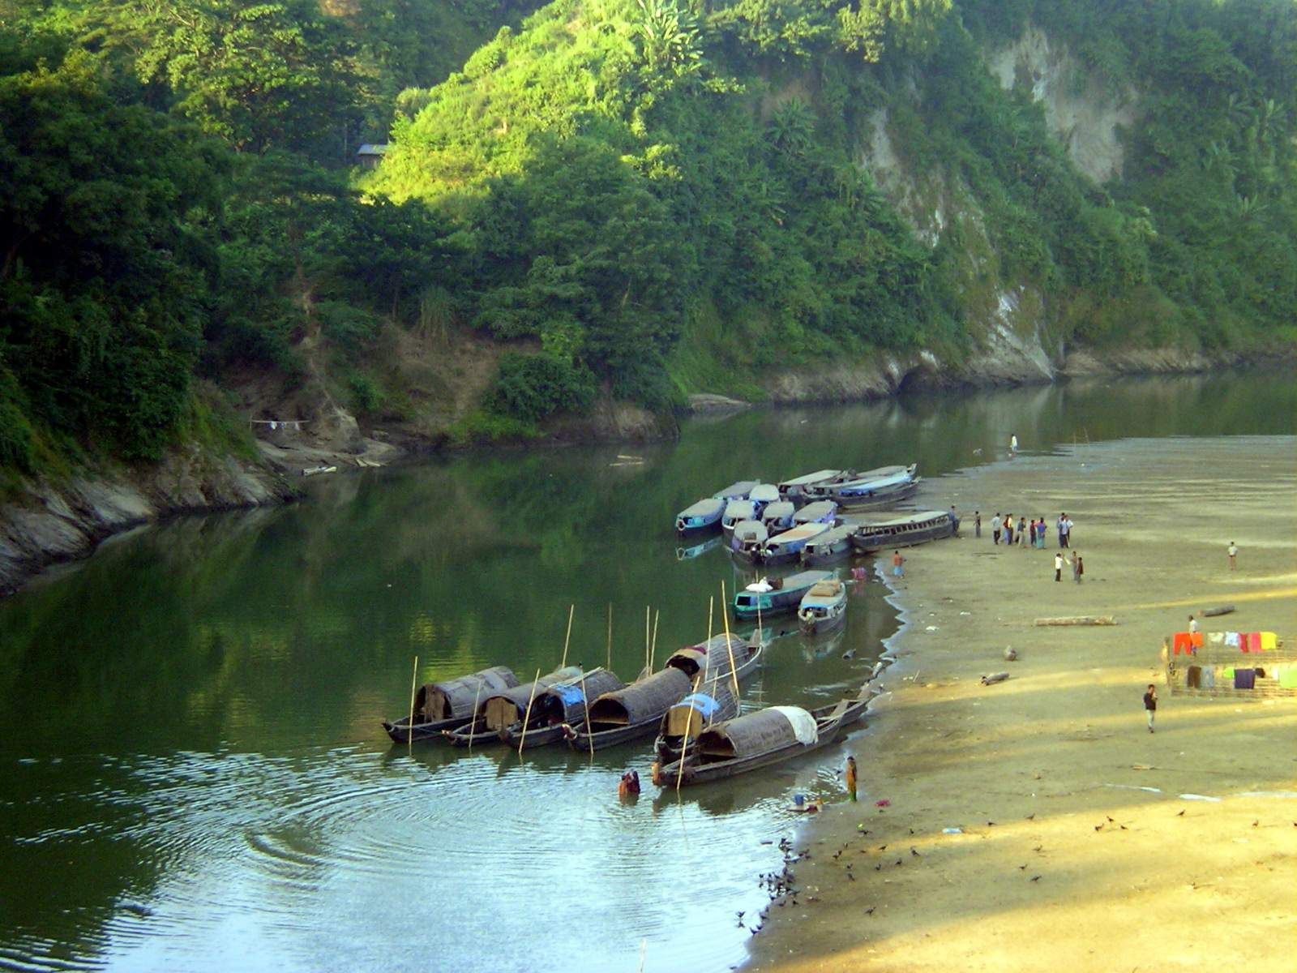
A Special Escape
Overview of Thanchi, Bandarban
About This Place
Thanchi Upazila is one of the most beautiful and peaceful places in Bangladesh. Surrounded by green hills, rivers, and natural beauty, it offers a perfect escape from busy city life. The Sangu River flows through the area, creating breathtaking landscapes. This 3-day trip with my friend became one of the most memorable experiences of my life.
📅 Dec 20–22, 2025 3 Days
📍 Thanchi Bandarban, BD
Ibtiaz Chowdhury | ID: 261031023 | Dept. of CSE, 36th Batch (UG)
2/8

Slide 3
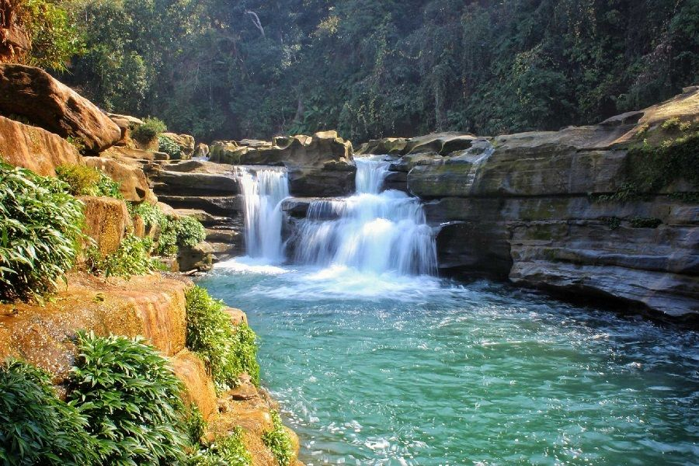
Things to Do in Thanchi
🚤 Boat Ride on the Sangu
💧 Nafakhum Waterfall Trek
🏔️ Hill Viewpoints
Glide through crystal-clear water flanked by green hills. A peaceful, magical experience.
Trek through the jungle to reach one of Bangladesh's most powerful waterfalls. Worth every step.
Climb to stunning viewpoints surrounded by mist and green forests. Views that take your breath away.
Ibtiaz Chowdhury | ID: 261031023 | Dept. of CSE, 36th Batch (UG)
3/8

Slide 4
Sangu River
A River of Peace · Day 1
Day 1 Experience
I visited the Sangu River on the first afternoon in Thanchi. The clear water and peaceful environment made me feel calm and completely relaxed. Taking a boat ride was one of the best decisions of the trip. "The whole world seemed to slow down just for us. I had never felt so peaceful in my entire life."
Ibtiaz Chowdhury | ID: 261031023 | Dept. of CSE, 36th Batch (UG)
4/8

Slide 5
Nafakhum Waterfall — The Big Adventure
Day 2: The Trek
After a boat ride to Remakri, we trekked through the jungle. The path was steep and muddy — but the greenery made it enjoyable. "When I finally heard the roar of the waterfall, all the tiredness disappeared instantly. It was powerful. Breathtaking. It was worth every step."
Ibtiaz Chowdhury | ID: 261031023 | Dept. of CSE, 36th Batch (UG)
5/8

Slide 6
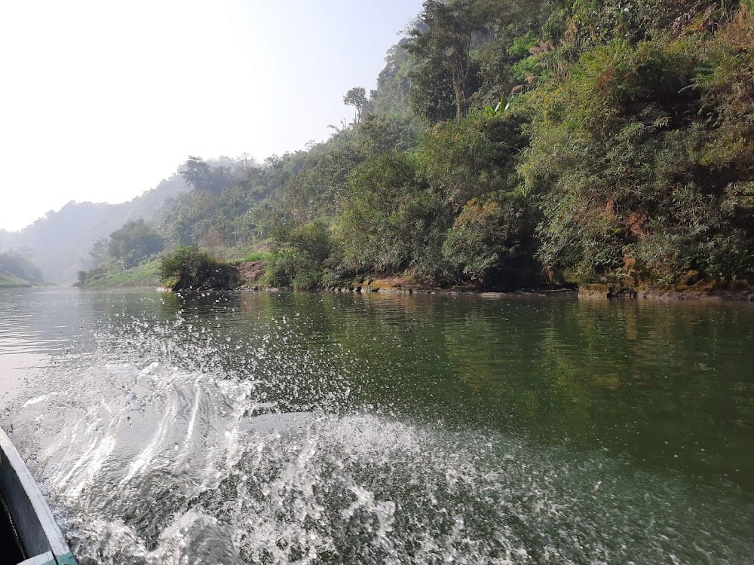
My Favorite Memory
A Day to Remember
The Moment I Remember Most
Standing at the edge of Nafakhum Waterfall was the best moment of the entire trip. My friend and I just stood in silence, letting the mist hit our faces. Neither of us said anything. We just smiled. "That moment of silence was louder than anything. Pure happiness."
Ibtiaz Chowdhury | ID: 261031023 | Dept. of CSE, 36th Batch (UG)
6/8

Slide 7
What I Learned
"I went for the adventure. I came back with something more — a clearer head and a deeper appreciation for simple things."
🏔️
Hard paths lead to the best views
The trek to Nafakhum was not easy. But when I heard that waterfall, none of the difficulty mattered. It was worth every step.
🌊
Nature resets the mind completely
I did not expect the hills and river to affect me so much. Standing by the Sangu, I felt more at peace than I had in a very long time.
📸
Some moments deserve to be remembered
This trip forced me to slow down, look around, and actually feel the place I was in. I want to do that more in life.
Ibtiaz Chowdhury | ID: 261031023 | Dept. of CSE, 36th Batch (UG)
7/8

Slide 8
Thank You
for your attention!
"Thanchi is not just a place. It is a feeling."
Presented By
Ibtiaz Chowdhury
ID: 261031023
Dept. of CSE · 36th Batch (UG)
Ibtiaz Chowdhury | ID: 261031023 | Dept. of CSE, 36th Batch (UG)
8/8

