Slide 1
My Favorite Place
Thanchi: A Memorable Tour
with My Friend
English Assignment · CSE UG 36th Batch · December 2025
Prepared By
Ibtiaz Chowdhury
ID: 261031023 · Dept. of CSE · 36th Batch (UG)
🏔️ Thanchi Upazila, Bandarban, Bangladesh
Ibtiaz Chowdhury | ID: 261031023 | Dept. of CSE, 36th Batch (UG)
1/10

Slide 2
Department of Computer Science & Engineering
Presentation
Introduction
Everyone has a favourite place that they love very much. My favourite place is Thanchi, which is located in Bandarban, in the Chittagong Hill Tracts of Bangladesh. I visited this beautiful place during a tour with my close friend. It was a very enjoyable and memorable experience for me. Surrounded by green hills, rivers, and natural beauty, Thanchi gave me an experience I will never forget.
Ibtiaz Chowdhury | ID: 261031023 | English [ENG-101]
2/8

Slide 3
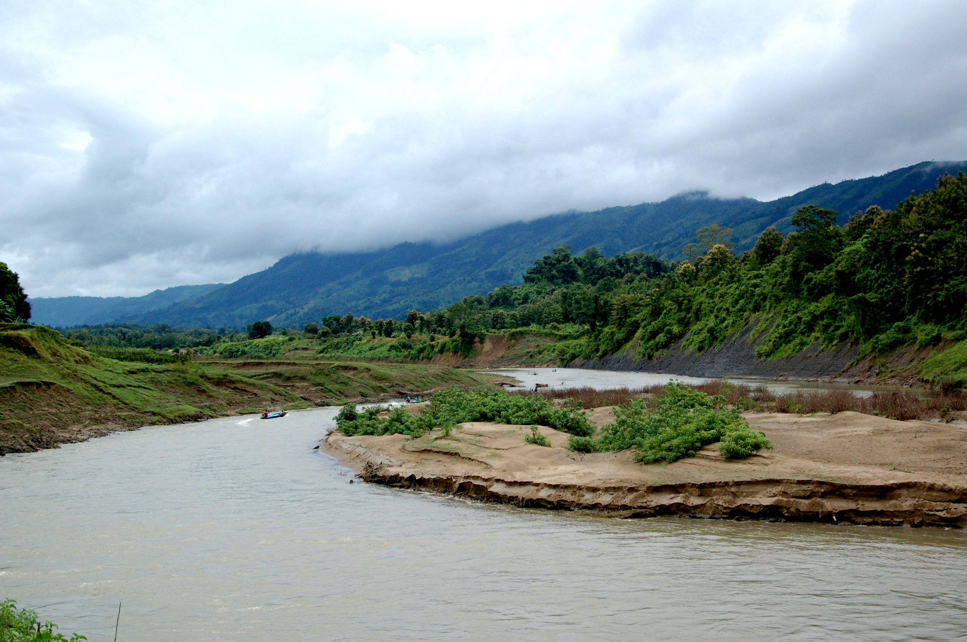
Department of Computer Science & Engineering
Presentation
About Thanchi
• Thanchi is in Bandarban district, Chittagong Hill Tracts, Bangladesh. • One of the most beautiful and peaceful places in the country. • Famous for the Sangu River, Nafakhum Waterfall, and green hills. • Home to indigenous communities with rich culture and tradition. • Surrounded by dense forests, rivers, and breathtaking scenery.
Ibtiaz Chowdhury | ID: 261031023 | English [ENG-101]
3/8

Slide 4
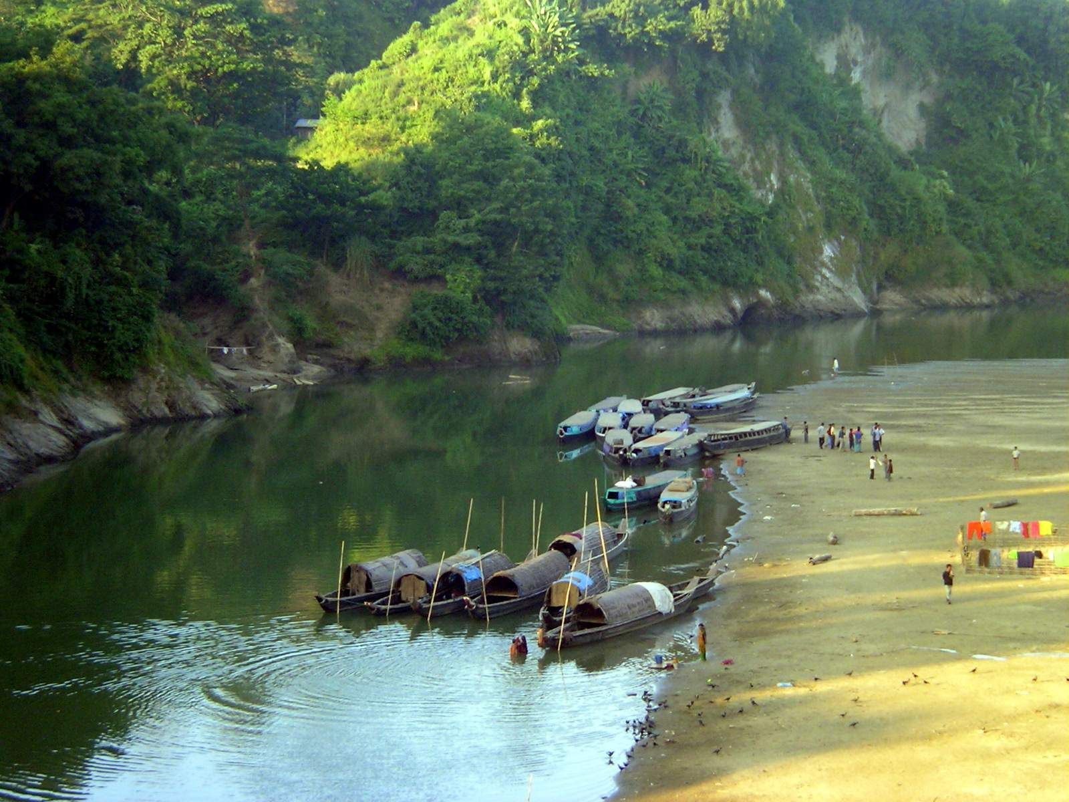
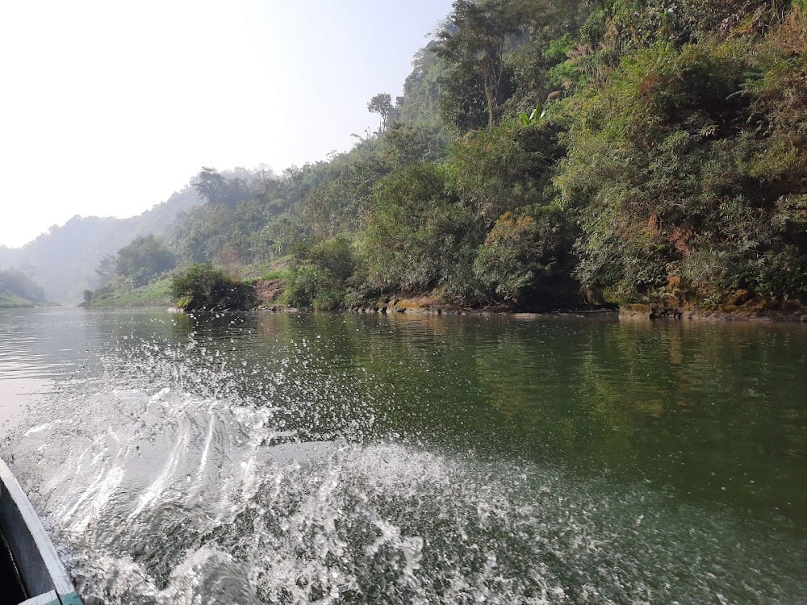
Department of Computer Science & Engineering
Presentation
First Impression
When we reached Thanchi, I was amazed by its natural beauty. The Sangu River was crystal clear and the surrounding hills were breathtaking. The fresh air made me feel completely relaxed and at peace. It was like stepping into a natural paradise far from the busy city.
"Spending time with my friend made this trip even more special."
Ibtiaz Chowdhury | ID: 261031023 | English [ENG-101]
4/8

Slide 5
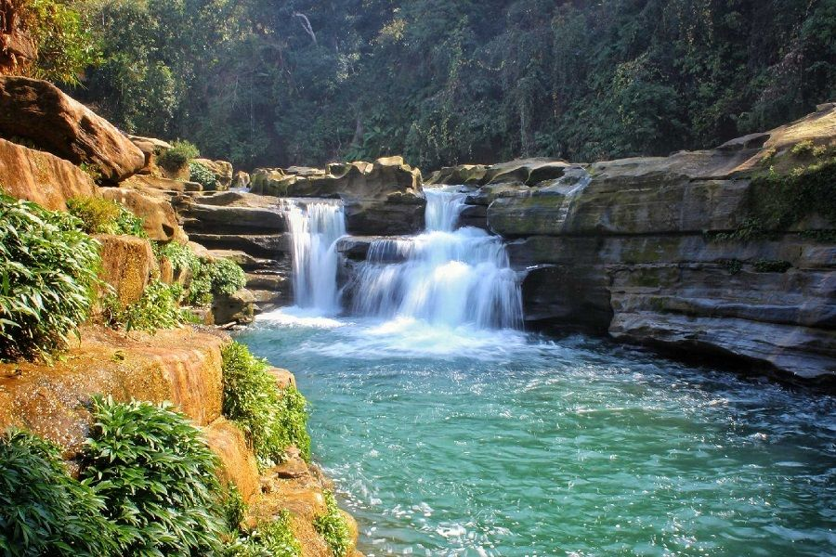
Department of Computer Science & Engineering
Presentation
Nafakhum Waterfall — Day 2 Adventure
On the second day, we trekked to the famous Nafakhum Waterfall. • Traveled by boat along the Sangu River to reach Remakri. • Then trekked through the jungle to Nafakhum. • The waterfall was powerful, loud, and breathtaking. "When I heard the roar of the waterfall, all my tiredness disappeared. Worth every step."
Ibtiaz Chowdhury | ID: 261031023 | English [ENG-101]
5/8

Slide 6
Department of Computer Science & Engineering
Presentation
Memorable Moments
Every moment of the trip was special and unforgettable. • The boat ride on the Sangu River was peaceful and magical. • Standing at Nafakhum Waterfall in silence with my friend was the best moment of the entire trip. • The green hills, fresh air, and clear rivers felt like a dream come true. • The sound of the river and mist from the waterfall will stay in my heart forever.
Ibtiaz Chowdhury | ID: 261031023 | English [ENG-101]
6/8

Slide 7
Department of Computer Science & Engineering
Presentation
Conclusion
Thanchi is truly a wonderful and beautiful place. It is my favourite place because of its natural beauty, the Sangu River, and Nafakhum Waterfall. This tour gave me happiness, adventure, and great memories. Spending time in nature with a close friend made it even more meaningful and unforgettable. I hope to visit Thanchi again in the future.
Ibtiaz Chowdhury | ID: 261031023 | English [ENG-101]
7/8

Slide 8
THANK YOU
It was a journey worth remembering. 🏔️
Presented By
Ibtiaz Chowdhury
ID: 261031023
Dept. of CSE · 36th Batch (UG)
🏔️ Thanchi, Bandarban · December 2025 · English Assignment
Ibtiaz Chowdhury | ID: 261031023 | Dept. of CSE, 36th Batch (UG)
10/10

