Slide 1
Department of Computer Science & Engineering
Presentation
Presentation Title:
My Favorite Place
Presenter Name:
Ibtiaz Chowdhury
ID No:
261031023
Batch:
36th
Department:
Computer Science & Engineering
Course:
English [ENG-101]
Ibtiaz Chowdhury | ID: 261031023 | English [ENG-101]
1/8

Slide 2
Department of Computer Science & Engineering
Presentation
Introduction
Everyone has a favourite place that they love very much. My favourite place is Thanchi, which is located in Bandarban, in the Chittagong Hill Tracts of Bangladesh. I visited this beautiful place during a tour with my close friend. It was a very enjoyable and memorable experience for me. Surrounded by green hills, rivers, and natural beauty, Thanchi gave me an experience I will never forget.
Ibtiaz Chowdhury | ID: 261031023 | English [ENG-101]
2/8

Slide 3
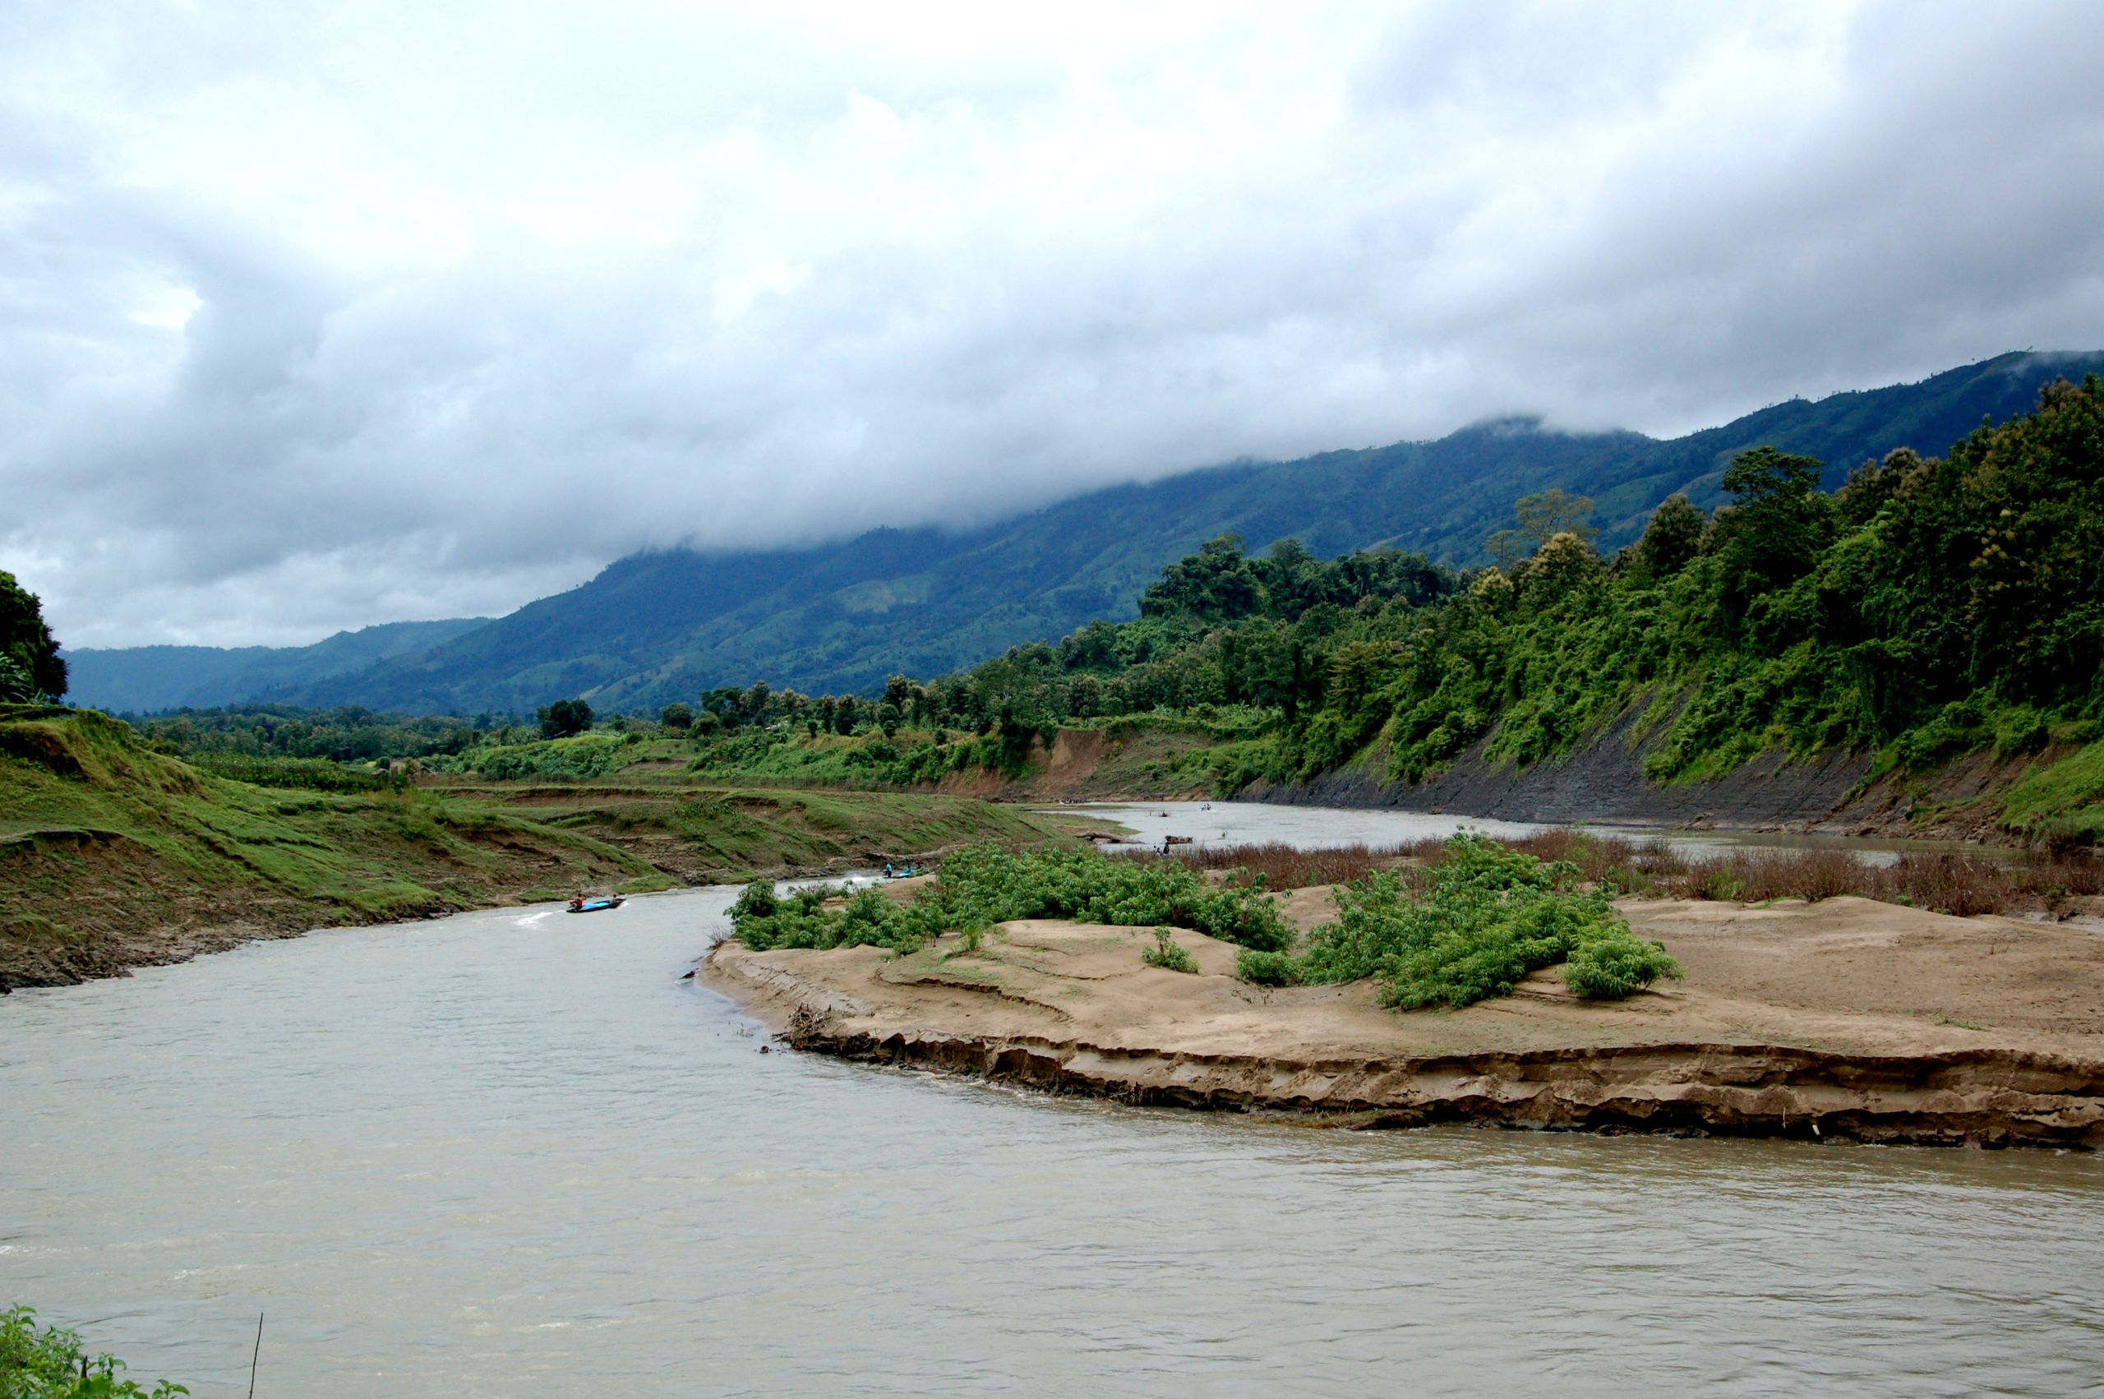
Department of Computer Science & Engineering
Presentation
About Thanchi
• Thanchi is located in Bandarban district, Chittagong Hill Tracts, Bangladesh. • It is one of the most beautiful and peaceful places in the country. • Famous for the Sangu River, Nafakhum Waterfall, and green hills. • The area is home to various indigenous communities with rich culture. • Surrounded by dense forests, rivers, and breathtaking natural scenery.
Ibtiaz Chowdhury | ID: 261031023 | English [ENG-101]
3/8

Slide 4
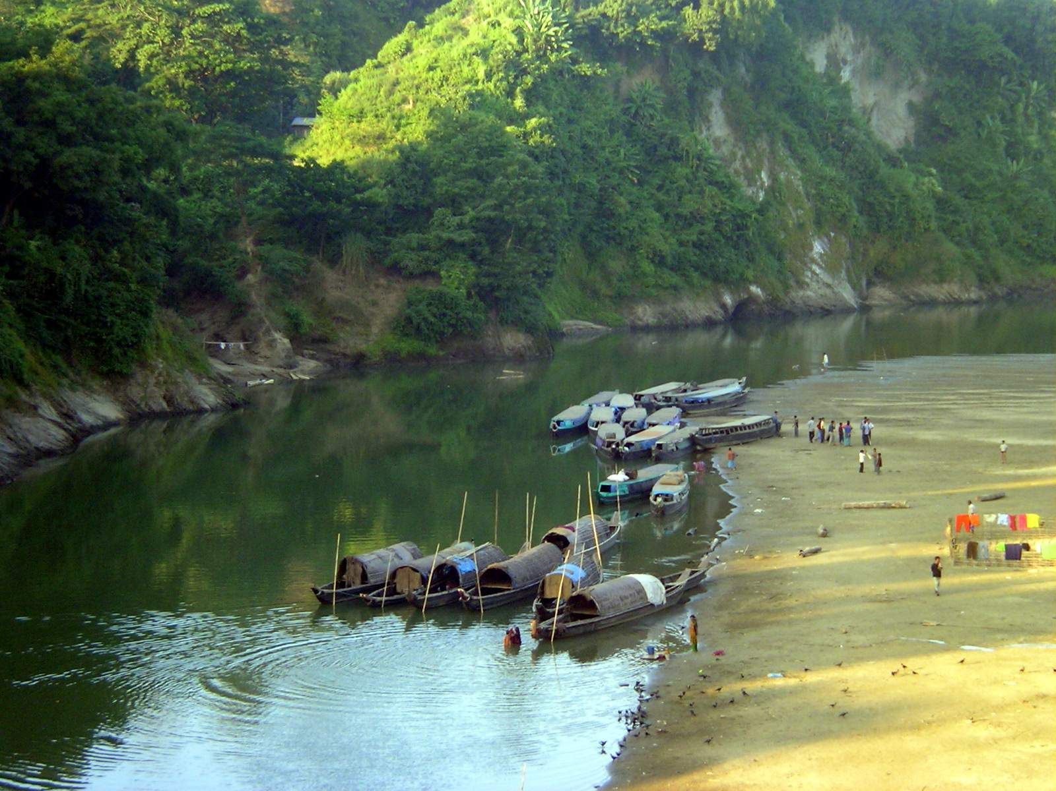
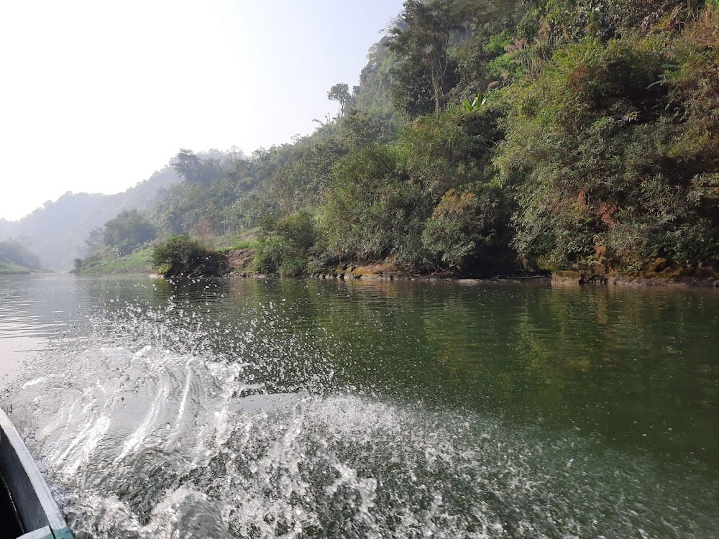
Department of Computer Science & Engineering
Presentation
First Impression
When we reached Thanchi, I was amazed by its natural beauty. The Sangu River was crystal clear, and the surrounding hills were breathtaking. The fresh air and peaceful environment made me feel completely relaxed. It was like stepping into a natural paradise far from the busy city.
Ibtiaz Chowdhury | ID: 261031023 | English [ENG-101]
4/8

Slide 5
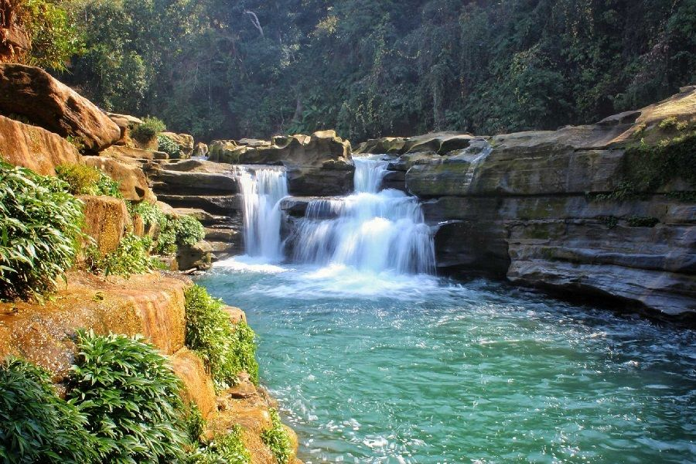
Department of Computer Science & Engineering
Presentation
Nafakhum Waterfall — Day 2 Adventure
On the second day, we trekked to the famous Nafakhum Waterfall. • We traveled by boat along the Sangu River to reach Remakri. • Then we trekked through the jungle to Nafakhum. • The waterfall was powerful, loud, and absolutely breathtaking. "When I heard the roar of the waterfall, all my tiredness disappeared. It was worth every step."
Ibtiaz Chowdhury | ID: 261031023 | English [ENG-101]
5/8

Slide 6
Department of Computer Science & Engineering
Presentation
Memorable Moments
Every moment of the trip was special and unforgettable. • The boat ride on the Sangu River was peaceful and magical. • Standing at Nafakhum Waterfall in silence with my friend was the single best moment of the entire trip. • The green hills, fresh air, and clear rivers felt like a dream come true. • The sound of the river and the mist from the waterfall will stay in my heart forever. • These moments will always be some of the best memories of my life.
Ibtiaz Chowdhury | ID: 261031023 | English [ENG-101]
6/8

Slide 7
Department of Computer Science & Engineering
Presentation
Conclusion
Thanchi is truly a wonderful and beautiful place. It is my favourite place because of its natural beauty, the Sangu River, and Nafakhum Waterfall. This tour gave me happiness, adventure, and great memories. Spending time in nature with a close friend made it even more meaningful and unforgettable. I hope to visit Thanchi again in the future.
Ibtiaz Chowdhury | ID: 261031023 | English [ENG-101]
7/8

Slide 8
Department of Computer Science & Engineering
Presentation
Thanks for Listening!
Ibtiaz Chowdhury
ID: 261031023 · Batch: 36th
Dept. of Computer Science & Engineering
English [ENG-101]
Ibtiaz Chowdhury | ID: 261031023 | English [ENG-101]
8/8

